Slide 1


Final Project
Proudly presented by Team ZeeGerman´s

Slide 2
The Team - the good the bad and the ugly
The „good“ – Project Leader Sebastian (Frontend, Design, Special)
The „bad –> wicked sexy“ code by Henry (Design, Backend, Frontend)
The „ugly -> nice“ code by Mathias (Backend, Design, Presentation)

Slide 3
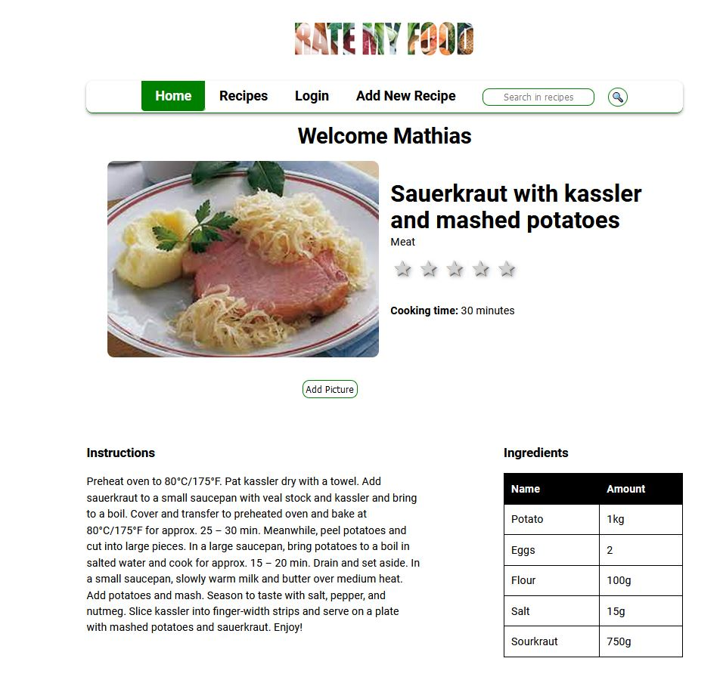
Rate My Food - Website

Slide 4
First Steps
team distribution of tasks
Github for Front- & Backend
https://github.com/sadltelekom/RateMyFood.git
https://github.com/sadltelekom/RateMyFoodFrontend.git
& Springboot add (by Sebastian)

Slide 5
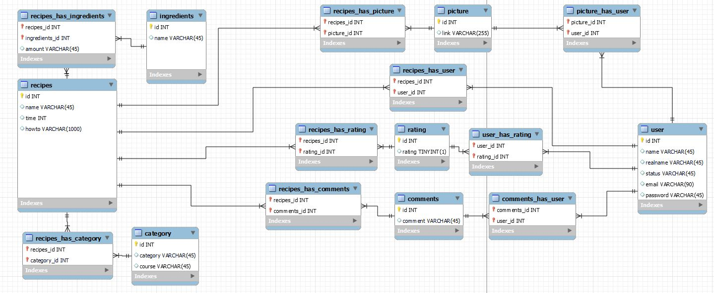
Database plan & design

Slide 6
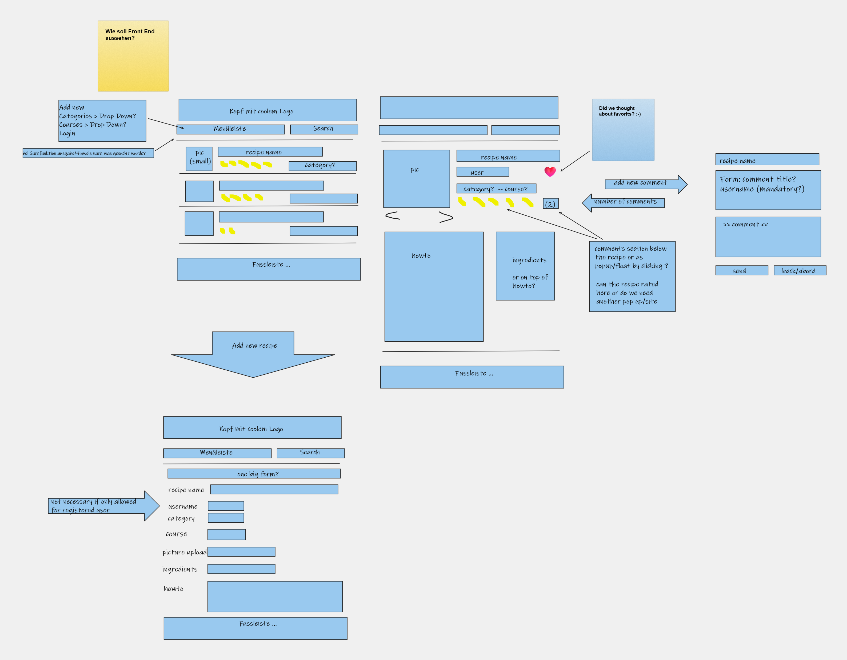
Frontend

Slide 7
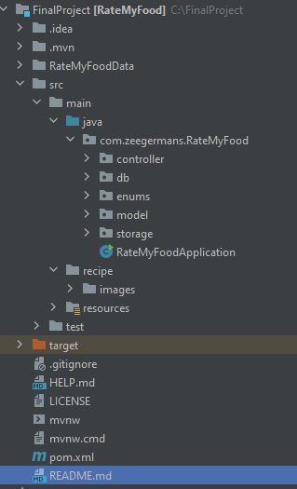
Java Backend Structure (ordered)

Slide 8
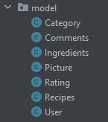
Java – model classes

Slide 9
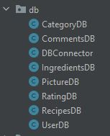
Java – database´s

Slide 10
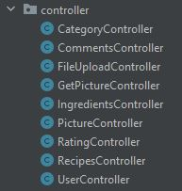
Java – controller

Slide 11
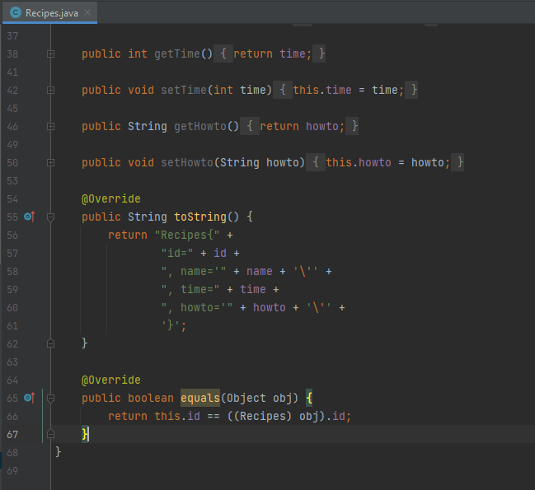
Recipes

Slide 12
Team Struggles
Place - Angular / Frontend
Design discussions
Something with the „footer“

Slide 13
Learnings
You can not do all … separate the needed Parts
Git is a lot of „FUN“
JAVA is awesome ☺

Slide 14
Thank all of you -
for the great time ☺

